Slide 1
Expert System for Diagnosing Heart Disease 1.0

Slide 2
Team Members
Navya
Chaitanya
Atharva
Vikram

Slide 3
Presentation Overview
Introduction
Purpose and Constraints
Requirements Glossary
Functional Requirements (Use Case Diagram)
Non - functional Requirements
Technical Requirement
Project Risks
System Requirements(Prototype)

Slide 4

Introduction
Client - Dr. Hajiarbabi
Assistant Professor of Computer Science at PFW
The Expert System for Diagnosing Heart Disease is a project aimed at developing a web-based expert system that will assist healthcare professionals, common patient, particularly doctors and physicians, in diagnosing a wide range of heart diseases.

Slide 5
Purpose
The purpose of designing an expert system for diagnosing heart disease (Heart Disease 1.0) is to provide a technology-based solution that can assist healthcare providers and patients in making early, accurate, and consistent diagnoses of heart disease. This system aims to reduce human errors, offer access to specialized medical knowledge, provide timely responses, support healthcare professionals, improve cost efficiency, educate patients, enable remote healthcare, and efficiently manage patient data, ultimately enhancing the quality of care and patient outcomes.

Slide 6
Requirement Glossary
Expert System: A computer system that emulates the decision-making ability of a human expert in a particular domain.
Heart Disease: A term for various conditions that affect the heart, including coronary artery disease, cardiac arrest, Angina and arrhythmias.
Patient Details: Information about the patient, including personal information, medical history, and diagnostic data.
Doctor/Physician: User of the system who uses patient data and interacts with the system to diagnose heart diseases.
Diagnosis: The determination of the specific heart disease affecting a patient based on their symptoms and medical history.
Parameters: Medical, physiological, and clinical data used for diagnosing heart diseases.

Slide 7
Functional Requirements
1. User Registration (Patient,Doctor):
• The patient can register in the system with their personal information.
2. User Login (Patient, Doctor):
• Both patients and doctors can log in using their credentials.
3. Symptom Input (Patient):
• The patient can input their symptoms, medical history, and lifestyle information.
4. Preliminary Diagnosis (Machine Learning Module):
• The AI/ML component processes the patient's input to generate a preliminary diagnosis.
5. Consultation Request (Patient):
• The patient can request a consultation with a doctor.
6. Consultation Scheduling (Doctor):
• The doctor can schedule consultations based on patient requests.

Slide 8
Functional Requirements
7. Consultation (Doctor):
• The doctor can review the patient's input and system-generated preliminary diagnosis.
8. Additional Tests (Doctor):
• The doctor can request further diagnostic tests if necessary.
9. Final Diagnosis (Doctor):
• The doctor can provide a final diagnosis and treatment recommendations.
10. User Interface (Web Interface):
• Provides a user-friendly interface for patients and doctors to interact with the system.
11. System Maintenance (Administrator):
• The administrator can manage user accounts, update medical data, and ensure system availability.

Slide 9
User Requirements
A use case diagram visually represents the interactions between users (actors) and the system. For a heart disease diagnosis expert system, we will identify the actors and their interactions with the system.
Actors:
1. Patient: The individual seeking a heart disease diagnosis.
2. Doctor: A medical professional who interacts with the system to review and confirm diagnoses.
3. Machine Learning Module: Represents the AI/ML component responsible for making preliminary diagnoses based on input.
4. Web Interface: The user interface through which patients and doctors interact with the system.
5. Administrator: The person responsible for system maintenance and user management.

Slide 10
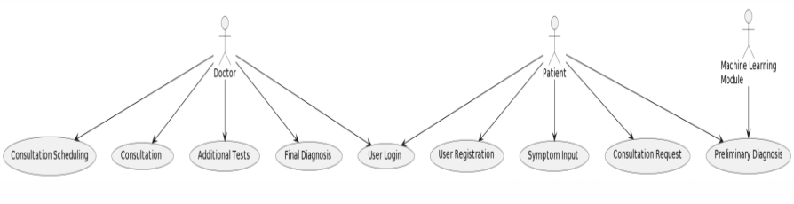
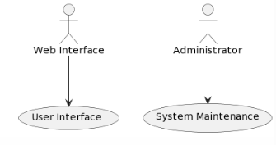
Use Case Diagram

Slide 11
Non-Functional Requirements
Performance
Requirement: The system should respond to user queries and provide diagnoses within few minutes of user interaction.
Justification: Quick responses are crucial for the system's usability and to ensure efficient diagnosis.
Reliability
Requirement: The system should have a 99% uptime, with minimal downtime for maintenance.
Justification: Healthcare professionals rely on this system for critical patient assessments, making high reliability essential.
Security
Requirement: All patient data should be encrypted and compliant with health data privacy regulations
Justification: Protecting patient data and complying with legal requirements is a top priority.
Usability
Requirement: The system should have an intuitive web user interface and provide clear, easy-to-understand diagnostic results.
Justification: Healthcare professionals with varying levels of technical expertise should be able to use the system effectively.
Scalability
Requirement: The system should be able to handle a growing number of patient data records and concurrent users.
Justification: To accommodate the increasing usage and data volume over time.

Slide 12
Expert System - ML Workflow
Business Understanding
Monitoring & Maintenance
Data Understanding
Model Deployment
Data Preprocessing
Model Evaluation
Model Training

Slide 13
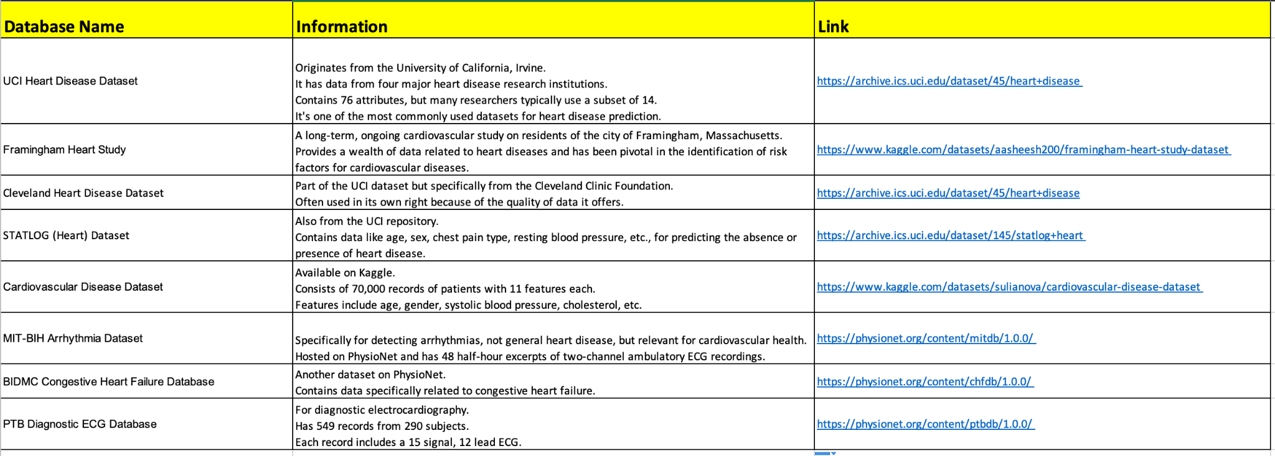
Expert System - Datasets Analysis

Slide 14


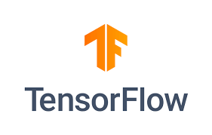






Expert System - Technologies that may be used

Slide 15
Project Risks
Inaccurate Diagnoses: The system may provide incorrect diagnoses, leading to incorrect treatment recommendations and patient harm.
Data Security Breach: Risk of unauthorized access to patient data, leading to privacy violations and legal consequences.
Integration Challenges: Difficulty integrating the system with existing healthcare IT infrastructure and electronic health records systems.
Regulatory Compliance: Risk of non-compliance with healthcare data regulations, resulting in fines and legal issues.
Scalability Issues: As the user base grows, the system may struggle to handle the increasing load and data volume.

Slide 16
Risk Mitigation
Accuracy Improvement: Model the expert system in a way that minimizes false negatives/false positives
Data Security: Implement strong encryption and access control measures, regularly update security protocols, and conduct security audits.
Integration Planning: We have divided the workflow into - database, frontend, and backend for seamless integration
Regulatory Compliance: If our client (Dr. Hajiarbabi) wants to launch our product, it may need regulatory compliance. However, with our recent meetings with him, he wants to use this project for research purposes only.
Scalability Planning: To mitigate the risk of scalability in the project, we will adopt scalable architecture, implement load testing, monitor system performance, optimize code and queries

Slide 17
Prototype
https://heart-disease-se.bubbleapps.io/version-test?debug_mode=true

Slide 18
The End

